Slide 1
Higher Education Leadership in Uncertain Times
Ralph C. Wilcox
Provost and Executive Vice President
University of South Florida
Presented at the SUS Institute for Academic Leadership’s
Department Chairpersons’ Workshop
October 2, 2016
Notes:
Welcome
Introductions and disclaimers

Slide 2
Purpose
To assess the changing landscape of contemporary public higher education along with the needs and attributes of effective leaders,
To identify “best practices” for consideration by department chairs, directors, and deans to advance their units in challenging times, and
To add to your leadership “toolkit” as you navigate a professional world characterized by ambiguity.
Notes:
We’re are fundamentally ill-prepared to lead (most of us were and are professors at heart) – we know how to generate new knowledge and effectively communicate such to our students or to approach complex problem solving through our research, but…

Slide 3
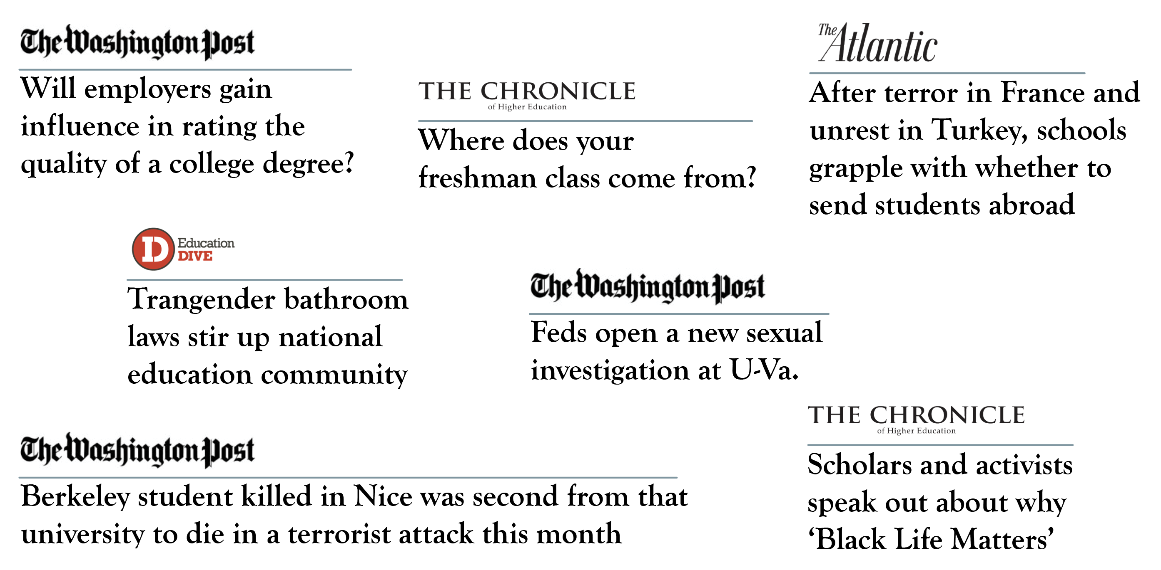
Public Higher Education Today
Notes:
You are not alone!
The challenges we face – and the Department Chair is at “ground zero”.

Slide 4
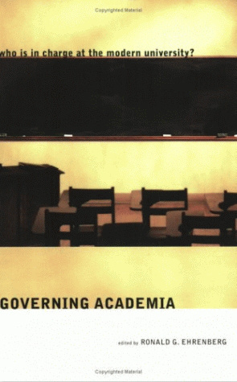
Public Higher Education Today

Slide 5
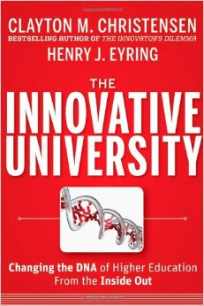
Public Higher Education Today

Slide 6
Public Higher Education Today
Notes:
“Declining by Degrees” –
“Ivory Tower” – the skyrocketing cost of higher education
“Starving the Beast”
This documentary examines the on-going power struggle on college campuses across the nation as political and market-oriented forces push to disrupt and reform America’s public universities. The film documents a philosophical shift that seeks to reframe public higher education as a ‘value proposition’ to be borne by the beneficiary of a college degree rather than as a ‘public good’ for society. Financial winners and losers emerge in a struggle poised to profoundly change public higher education. The film focuses on dramas playing out at the University of Wisconsin, University of Virginia, University of North Carolina, Louisiana State University, University of Texas and Texas A&M.

Slide 7
Is there Opportunity amidst the Chaos, Disruption and Change in Higher Education?
How Do We Balance Competing Priorities?
Access or Accountability?
Public Good or Private Gain?
Inputs or Outputs?
Affordability or Quality?
Research or Teaching?
Education or Workforce Training?
Notes:
Volatility in the financial markets
Instability in national and global politics
And, Ambiguity in Higher Education
There is a CONFLATION of different values and constituents
Attacks on Free Speech (trigger warnings and campus climate issues)
Combating sexual assault on campus
Campus safety and security
Intrusion of Government (at all levels) and Governance – an assault on shared governance
Technology - is it the panacea for skyrocketing costs? Online education and Student Success (Predictive Analytics)
Emphasis on Degree Completion and workforce
Ubiquity of Data to inform decision making and assessment
Budget models: the Rise of RCM (to reduce costs/foster efficiency & transparency/encourage greater autonomy and accountability within units
Learning spaces – focused on Collaboration, Ingenuity, and “gaming/playing”
Not for the faint of heart – the need for “a steady hand”.

Slide 8
The Key Drivers of Contemporary Public Higher Education
Access
Affordability
Accountability

Slide 9
Affordability
E&G Funding per FTE Student
State and Total funding for 2009-10 and 2010-11 includes federal stimulus. The decrease in 2012-13 was partially due to a one-time reduction of $300 M. Adjusted for inflation.
Source: Board of Governors | State University System of Florida
Notes:
That’s a 54% increase in tuition and a 26% reduction in state funding per FTE (from its peak), resulting in a 6% decrease in overall funding per FTE student since our peak in AY 2006/07. Most important, the student’s share has grown from 29% (in AY 2003/04) to 45% of total funding this year.
A recent report from SHEEO (The State Higher Education Executive Officers) placed Florida at #24 in higher education spending/student ($6,271) with 3rd lowest tuition (behind CA and WY) and 3dr highest student population (behind CA and TX).
Wyoming at #1 ($17,300 with 2nd lowest tuition)); NY (#5; $8,830 with 13th lowest tuition and 4th in student population); CA (#7; $8,522 with lowest tuition and highest student population); and TX (#13; $7,748 with 16th lowest tuition and 2nd highest student population)
National average per student FTE investment = $6,966 (18% less than before the recession)
National average tuition is: $6,006
But let’s not forget, we always think “the grass is greener” until we’ve been there. Today, 47 states are spending less per student on higher education than before the recession

Slide 10
Accountability
BOG Preeminence Metrics 2016 Evaluation
Percent of Bachelor’s Graduates Employed and/or Continuing their Education Further 1 Year after Graduation
Median Average Wages of Undergraduates Employed in Florida 1 Year after Graduation
Average Cost per Undergraduate Degree to the Institution
Six Year Graduation Rates (Full-time and Part-time FTIC)
Academic Progress Rate (2nd Year Retention with GPA above 2.0)
Bachelor’s Degrees Awarded in Areas of Strategic Emphasis (including STEM)
University Access Rate (Percent of Undergraduates with a Pell Grant)
Graduate Degrees Awarded in Areas of Strategic Emphasis (including STEM)
Board of Governors’ Choice Metric
Board of Trustees’ Choice Metric
Notes:
Burdensome REGULATORY REPORTING at all levels

Slide 11
The Importance of Values Driven Leadership
Know where you are…
Know where you are heading…
Know what it will take to get you there…
Consistency, focus, and discipline in leadership…

Slide 12
The Importance of Values Driven Leadership
Remember our raison d’être
Student Success
Problem Solving
Partnership
Notes:
Higher Education as an INVESTMENT not a COST (Tax)
Student success
Problem solving
Stay Focused, Disciplined and Consistent
Optimize Communication – with your students, faculty and staff as well as with your dean (other chairs/partners) and external constituents – meet regularly (especially at the outset)
Collaborative Planning informed by Data Analysis
Transparent Accountability (faculty and staff evaluations)
Set the Example and Mentor
Above all:
INTEGRITY – INDUSTRY/ENERGY – RECOGNIZE ONE’S LIMITS – GOOD HUMOR – MAKE A DIFFERENCE

Slide 13
The Importance of Values Driven Leadership
Don’t lose sight of the Big Picture and Stay Relevant
Optimize Communication
Stay Focused, Disciplined, and Consistent
Sponsor Collaborative Planning Informed by Data Analysis
Promote Transparent Accountability
Set an Example as Leader, Scholar, and Teacher
Invest in Mentoring and Faculty/Staff Development

